Slide 1
How to Setup Your Own Food Processing Industry
Presented by
Dr. Suvrat Kumar Singh
Professor,
Department of Food Process Engineering
SHUATS, Prayagraj (UP)
Presented to
AFSTI NIFTEM CHAPTER &
ALABHYAM
(NIFTEM Technical Society)
Department of Food Process Engineering
Vaugh Institute of Agricultural Engineering and Technology
Sam Higginbottom University of Agriculture, Technology and Sciences
Allahabad -211007, U.P.

Slide 2
OBJECTIVE
To motivate students to take-up Entrepreneurship as their career.
To pursue students to access self, recourse, and market opportunity.
To introduce students with Licensing/Registration/ Approval/ NOC.
“Target to be an employer – not an employee”
by
Shri Narendra Modi
Prime Minister of India

Slide 3
How Idea Pops-up in Mind
Gut Feeling
Market Research & Survey
Work Experience in the Business Segment
Diversification of Family Business
Expansion of Family Business – inn allied business segment
“If your mind can conceive it, your heart can believe it, then you can achieve it.”
“No idea is a small idea” - Dhirubhai Ambani

Slide 4
Self-Assessment
“The pursuit of opportunity without regard to resources currently controlled.”
- Howard Stevenson (Harvard)

Slide 5
Ask questions to yourself before starting business
Am I a visionary?
Am I focused enough?
Am I determined enough?
Am I energetic enough?
Am I a risk-taker?
Am I self-confident?
Am I creative? Do I have tolerance for failure?
Do I have tolerance for ambiguity?
Do I have experience in the field?
Do I have resources – finance, collateral?

Slide 6
Resource Assessment
‘All our knowledge begins with the senses, proceeds then to the understanding, and ends with reason. There is nothing higher than reason.’
–Immanuel Kant

Slide 7
Ask questions about Resources before starting business
Is raw material available?
Is man-power available?
Is water quality and availability good?
Is power-supply/ fuel adequate?
Is storage facility sufficient in the area?
I road/ rail connectivity good?

Slide 8
Market Assessment
“The founding of new businesses is the essence of entrepreneurial activity.”
- W. Gibb Dyer, Jr. (BYU)

Slide 9
Ask questions about market before starting business
Is there a demand-supply gap?
Can I trap the gap?
Can I bump-out a competitor?
Can I develop a unique business model?
Can I make my share in the niche-market by proposing Unique Sale Proposition (USP)?
Can I innovate a product that is readily accepted in market?

Slide 10
Types of Company (Basic)
Private
Public
One person Company (Pvt. Ltd.)
2 or more person
7 or more person
1 person
E.g. Cargill
E.g. NFL
E.g. Parle

Slide 11
Types of Company (Basis of incorporation)
Statutory
Registered
Act of parliament
Under company Act
E.g. LIC
E.g. ITC
Company act don’t apply

Slide 12
Types of Company (Basis of liability)
Unlimited liability company
Companies limited by guarantee
Members liable for undertaken amount
Members liable for company debt
Members act as guarantors for the company
Public or Private
Liability is unlimited
Companies limited by share
Members are liable as per memorandum amount
Members do not act as guarantors
Most common type of company

Slide 13
Company Size
“Entrepreneurs are self-reliant, opportunity-focused, willing to take risk and thrive on competition”

Slide 14
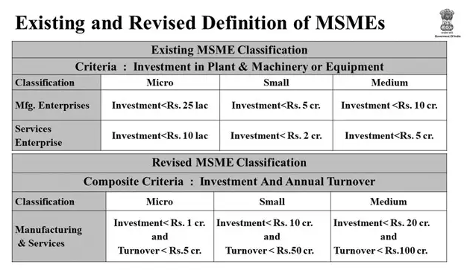

Slide 15
FSSAI Classification
Basic Registration – Annual turnover less than 12 lakhs
State License - Annual turnover between 12-20 crores
Central License - Annual turnover above 20 crores

Slide 16
Project Financing
‘Entrepreneurs who are not open to learning often compromise the degree of success they could achieve’

Slide 17
Sources and mode of financing
Sources
Equity- Capital investment by sponsors
Debt- Borrowed capital by bank and financial institution
Government Grants- Capital and Grant on loan under schemes
Finance Provider
Project Promotor- UBS Group
Individuals Investor- Warren Buffet
Banks- SBI
Institutional Investor- LIC
Capital Markets- Sensex
Institutional Financial Investor- Credit Unions
National Bank- HDFC, IDBI
Foreign Bank- Soft Bank
Financial Institution- Mutual Funds
Provide Finance as investment and share purchase
Provide Finance as Loans

Slide 18
Business Development Cycle
‘If you can’t plan and classify your documents – you can’t achieve’

Slide 19
Business Development Cycle
Strategic Planning
Business Concept
Assessments
Management Review
Detailed Project Report
Data Collection & Analysis
Legal Compliances & Project Execution
SOPS & Manpower in Place
Operation Execution/ Sale

Slide 20
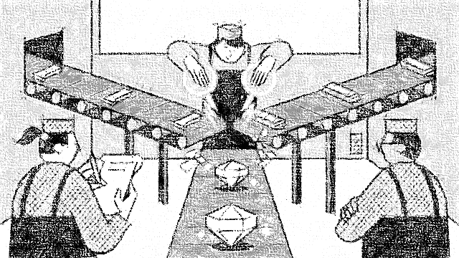
Licenses/Approvals/Registrations Required to Establish Food Processing Industry in India

Slide 21
Key Terms
Registration is the act of making an official record of names and other information.
License is official permission or permit to do, use, or own something.
Approval is the consent that someone or something is good or acceptable.
Certificate is a document that serves as written testimony for the truth of something.
No Objection Certificate (NOC) is a legal document issued from the authority that does not object to the agreement of a particular certificate.

Slide 22
How many number of Approval, Registration, Certificate, License & NOC are needed?
10
Registration
2
License
11
Approval
1
NOC
4
Certificate

Slide 23
Establishment
DIN (ROC)
DSC (ROC)
PAN (CBDT)
TAN (IT)
IEM (SSI)
GST (CBDT)
Pre-Construction
Land Acquisition
CTE (SPCB)
Construction NOC (DTP)
Fire Plan (DFS)
Electricity (SEB)
Post-Construction
FSSAI
Pollution NOC
Industrial Safety NOC
Waste Management (SPCB)
BIS
Fire NOC
BCC
Measurements (LMI)
IBR (CBB)
Post-Commencement
I-E Code (DGFT)
Employee Laws ( Labour Authority)
Water
Keys

Slide 24
Key
Establishing the legal entity which will carry on the business (eg: company)
Pre-construction of manufacturing unit
Post-construction of manufacturing unit
Post-commencement of operations

Slide 25
Section - A
Establishing the legal entity which will carry on the business

Slide 26
A. Establishing the legal entity which will carry on the business
Step No. | Approvals/Clearances Required | Concerned Department
1 | DIN (director identification number) | Registrar of Companies (ROC) http://www.mca.gov.in/MinistryV2/registrarofcompanies.html
2 | DSC (digital signature certificate is required. | Registrar of Companies (ROC) http://www.mca.gov.in/MinistryV2/registrarofcompanies.html
3 | Incorporation of a company Approval of the company name Appointing of directors Providing for a registered office | Registrar of Companies (ROC) http://www.mca.gov.in/MinistryV2/registrarofcompanies.html
4 | PAN - Permanent Account Number | Central Board of Direct Taxes https://www.incometaxindia.gov.in/pages/default.aspx

Slide 27
A. Establishing the legal entity which will carry on the business
5 | TAN - Tax Deduction Account Number | Income Tax Department https://www.incometaxindia.gov.in/pages/default.aspx
6 | IEM - Acknowledgement of Industrial Entrepreneur Memorandum (IEM) [Part I]. The promoter can file IEM in following categories: To setup a new factory To expand existing factory To manufacture a new article To graduate from SSI units to a large scale industry. | District Industry Centre for Small Scale Industries (SSI) Secretariat of Industrial Assistance (SIA) for medium and large industries https://dipp.gov.in/
7 | GST - Registration | GST Authority http://www.gstcouncil.gov.in/

Slide 28
Section - B
Pre-construction phase

Slide 29
B. Pre-Construction Phase
Step No. | Approvals/Clearances Required | Department to be Approached and Consulted
8 | Land Acquisition and usage related clearances | State Directorate of Industries (DI) Department of Town and Country Planning Local authority/ District Collector
9 | CTE - Consent to Establish (CTE) for setting up Factory / Building Premises Installation of Plant & Machinery Consent under Water and Air Pollution Control Acts. | State Pollution Control Board https://www.dpcc.delhigovt.nic.in/indexdup.php
10 | Land Clearance and approval of building layout & construction. NOC to commence construction activity. Land Occupancy certificate (from local authority) | District Town Planner Municipal and local authorities Inspector of Factories
11 | Approval of Fire Safety plan | State department/ directorate of fire services http://dfs.delhigovt.nic.in/home/Delhi-Fire-Services
12 | Permission for electricity connection and water use | State Electricity Board http://www.derc.gov.in/

Slide 30
Section - C
Post-construction phase

Slide 31
C. Post Construction Phase
Step No. | Approvals/Clearances Required | Department to be Approached and Consulted
13 | License to operate a “food business” under the Food Safety and Standards Act, 2006 - FSSAI | Officers under Food Safety and Standards Authority of India https://www.fssai.gov.in/
14 | Consent to Operate an industry under the Water (Prevention and Control of Pollution) Act, and the Air (Prevention and Control of Pollution) Acts. | State Pollution Control Board https://www.dpcc.delhigovt.nic.in/indexdup.php
15 | License to work a factory under the Factories Act, 1948 | Directorate of Industrial Safety and Health (DISH) https://dish.tn.gov.in/
16 | Consent of Establish (NOC) | State Pollution Control Board https://www.dpcc.delhigovt.nic.in/indexdup.php
17 | BIS Certification | Regional Office of the Bureau of Indian Standards (BIS) https://bis.gov.in/

Slide 32
C. Post Construction Phase
18 | Final Fire Approval | State department / directorate of fire services http://dfs.delhigovt.nic.in/home/Delhi-Fire-Services
19 | Building Completion Certificate (BCC) / Occupancy certificate | Local Municipal Authority
20 | Certificate of verification of electronic weighing machine under the Legal Metrology Act | Legal metrology inspector Department of Consumer Affairs, Food and Public Distribution
21 | IBR Cerificate - Boiler registration under the Indian Boilers Act IBR - Indian Boiler Regulation | Certified by company approved by Central Boiler Board (CBB)

Slide 33
Section - D
Post-Commencement of Operations

Slide 34
D. Post Commencement of Operation
Step No. | Approvals/Clearances Required | Concerned Department
22 | Import Export Code | - Set of guidelines and instructions as per Exim Policy or Foreign Trade Policy - Applicable for a period of 5 years under Section 5 of the Foreign Trade Act 1992 (Directorate General of Foreign Trade)
23 | Registrations under various labour laws such as: Employees’ Provident Funds and Miscellaneous Provident Act, 1952, Employees’ State Insurance Act, 1948 Contract Labour (Regulation and Abolition) Act, 1970. etc. as applicable | EPF save up a sufficient permanent fund for employees’ retirement. Employees’ State Insurance Act benefits in case of sickness, maternity and employment injury. Contract Labour Regulation and Abolition Act, 1970 to prevent exploitation of contract labour and providing better conditions of work. (Relevant labour authorities)

Slide 35
Notes
NOTES:- The timing for obtaining each registration may be fluid and will differ on a case to case basis depending on the requirements and business model chosen by the relevant company. The chart above shows is an indicative list of key permissions required to start and operate a food processing Industry in India. There could be specific registrations required depending on the size of investment, location / zone of the industry, nature of food item to be processed. Some of the specific registrations for which are not provided for above are: (i) MSME Registration, (ii) SEZ registration, (iii) registration for any incentive schemes, etc.

Slide 36
Disclaimer
This presentation is solely for informational purposes. The contents of this presentation are not, and are not intended to be legal advice. The reader / audience should seek specific legal advice by a counsel licensed to practice in India.

