Slide 1
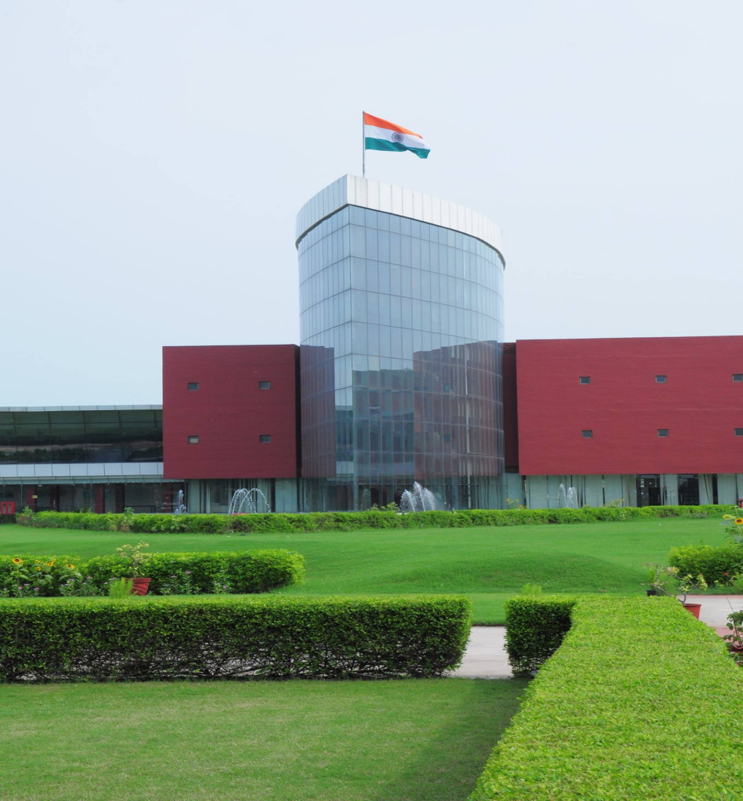


3-Days Training Programme on
Mushroom Production, Processing, Value Added Products and Value Chain
Organized Jointly by
Dept. of Agriculture and Environmental Sciences
& NIFTEM Pilot Plants
22-24 January 2025
Programme Outline
Demonstration of various mushroom production technologies.
Training on mushroom processing, post harvest management, processes and machinery.
Hands-on practice on production of value added products in NIFTEM Pilot Plants.
Sessions on GMP, GHP, quality control, packaging, regulations, Marketing and business, Mushroom value chain.
Medicinal mushrooms production and processing.
Visit to year round mushroom production and processing industries.
Who Should Participate ?
FPOs, SHGs, Budding Entrepreneurs, UG/PG students of Food Tech./Agril. Engg./ Agriculture or equivalent
National Institute of Food Technology Entrepreneurship and Management
(NIFTEM), Kundli , Sonepat, Haryana, 131028

Slide 2
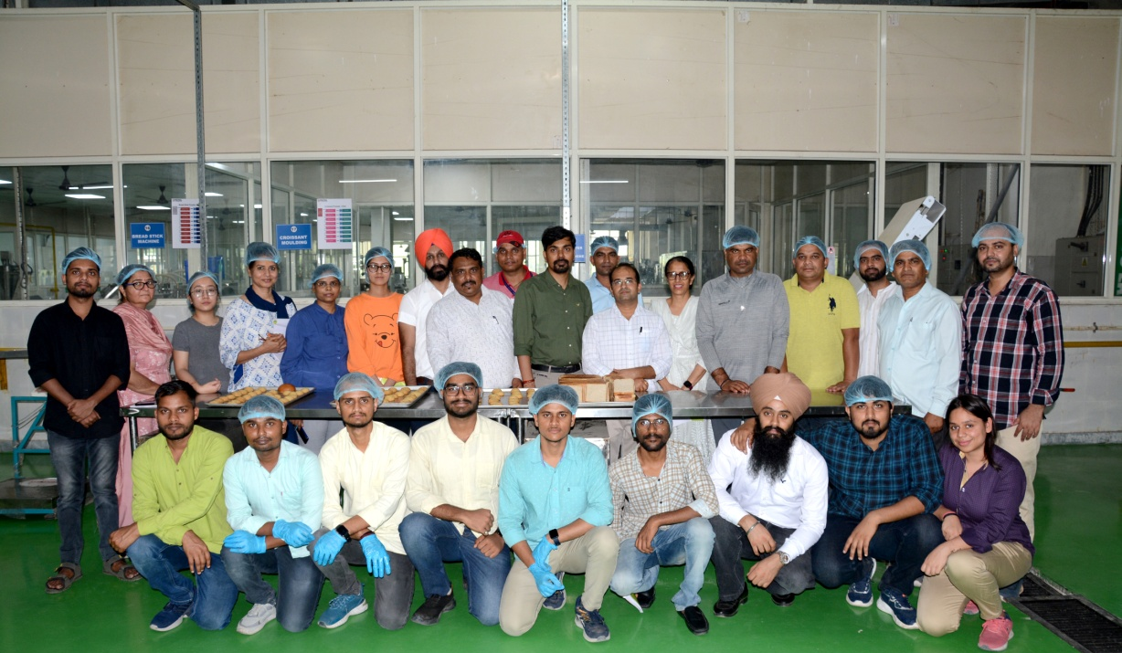
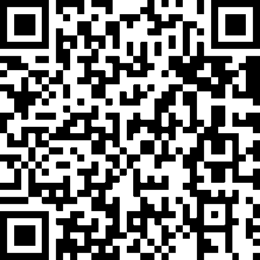
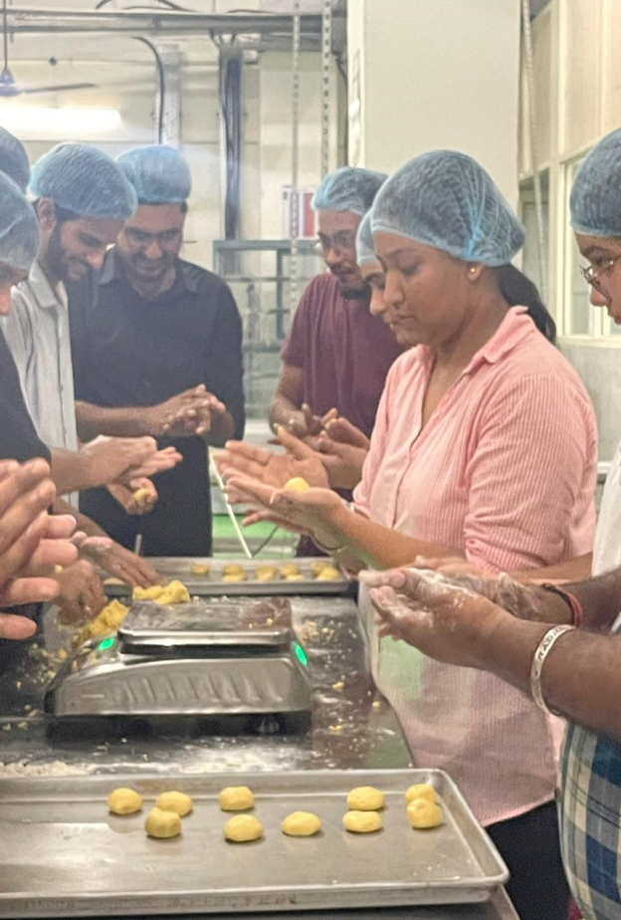
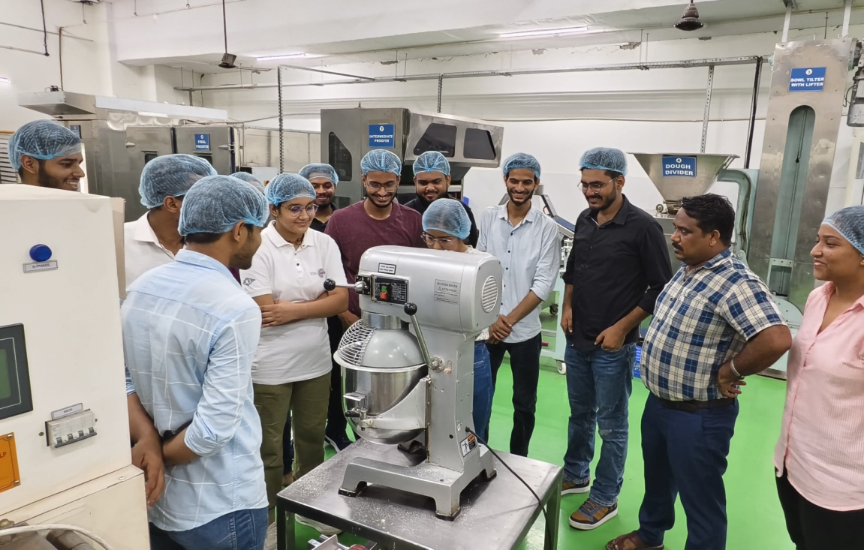
About NIFTEM, Kundli
Established in 2012 by the Ministry of Food Processing Industries (MoFPI), Govt. of India.
Recognized as an Institute of National Importance in 2021.
Dedicated to nurturing the growth of food processing sector and propelling the Indian food processing industry to new heights globally.
Key Takeaways from the Programme
Competencies to explore and identify the entrepreneurial opportunities in various types of mushroom value chain.
First hand practical outlook on mushroom production and processing.
Ability to innovate on value addition, shelf-life extension and packaging.
Know-how on recent trends of mushroom Entrepreneurship
Confidence in converting ideas to products / processes and then to business.
Training Fee/person
Rs. 6800/- with accommodation.
Rs. 5500/- without accommodation*
* Includes working lunch, tea and snacks.
For Registration, Scan this QR code OR Click / Use the link, http://surl.li/uieewu
For more information, Contact
Dr. Prasanna Kumar G V
Professor, Dept. of AES
Mobile: 8638941500
Email: prasanna@niftem.ac.in
Dr. Neeraj
Professor, Dept. of AES
Phone : 130-2281042
Email: neerajniftem@gmail.com
Er. Aditya Sharma
Manager, Pilot Plants
Mobile: 7015504639
Email: aditya.sharma@niftem.ac.in

